Slide 1

How to avoid memory issues?
Ben Khalfallah Héla

Slide 2
Some stats …
An Apple study found that 60-70% of vulnerabilities in iOS and macOS are memory safety vulnerabilities.
Google estimated that 90% of Android vulnerabilities are memory safety issues.
70% of all Chrome security bugs are memory safety issues.
Some of the most popular security issues of all time are memory safety issues: Slammer worm, WannaCry, Trident exploit, HeartBleed, Stagefright, Ghost.

Slide 3

Then …
What does “memory-safe” mean?

Slide 4


Memory unsafety is a property of some programming languages where they allow the programmer to introduce certain types of bugs and allow these bugs to cause serious security issues. These bugs deal with errors in how memory is used spatially and temporally.
Memory Safety

Slide 5
how is this possible?
How can we have memory problems when using a programming language based on the Garbage Collector?

Slide 6
GC isn’t a magician !
While the GC effectively handles a good portion of memory, it doesn't guarantee a foolproof solution to memory leaking. The GC is pretty smart, but not flawless. Memory leaks can still sneak up!

Slide 7

A memory leak is a situation where there are objects present in the heap that are no longer used, but the garbage collector is unable to remove them from memory, and therefore, they're unnecessarily maintained. A memory leak is bad because it blocks memory resources and degrades system performance over time. If not dealt with, the application will eventually exhaust its resources, finally terminating with a fatal java.Lang.Outofmemoryerror.
Memory Leak

Slide 8
Then …
Why can't the GC release unused memory?

Slide 9
Then …
Are there other types of memory problems that a program can cause?

Slide 10
What we’ll see ?
Running Program’s Memory
Allocating and Deallocating Memory in the Heap
Manual memory management
Automatic Reference Counting (ARC)
Garbage Collection
Memory Violations and How To Avoid Them
Buffer overflow
Null dereference
Dangling and wild pointers
Stack Overflow
Out of Memory (OOM)
Memory leaks
Multithreading and Race condition
Conclusion

Slide 11

Running Program’s Memory
C
Memory Layout

Slide 12
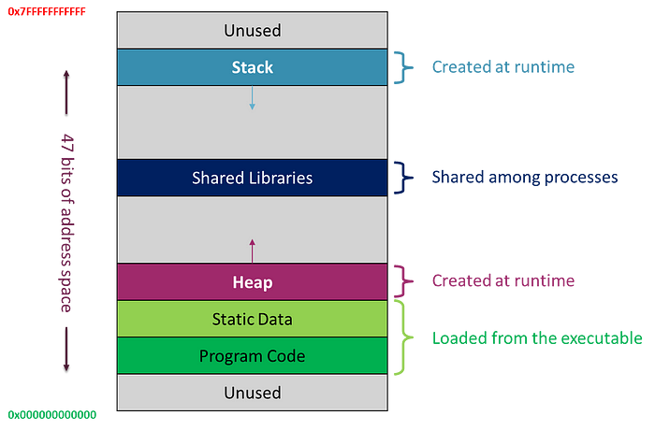
Running Program’s Memory
A typical memory layout of a running program can be as follows:
Static memory: static size, static allocation (compile time), for global variables, and static local variables.
Stack memory (Call Stack): static size, dynamic allocation (run time), for local variables.
Heap memory: dynamic size, dynamic allocation (run time). Its programmer controlled for some programming languages (variable-sized objects).
For all data, memory must be allocated (i.e., memory space reserved).

Slide 13
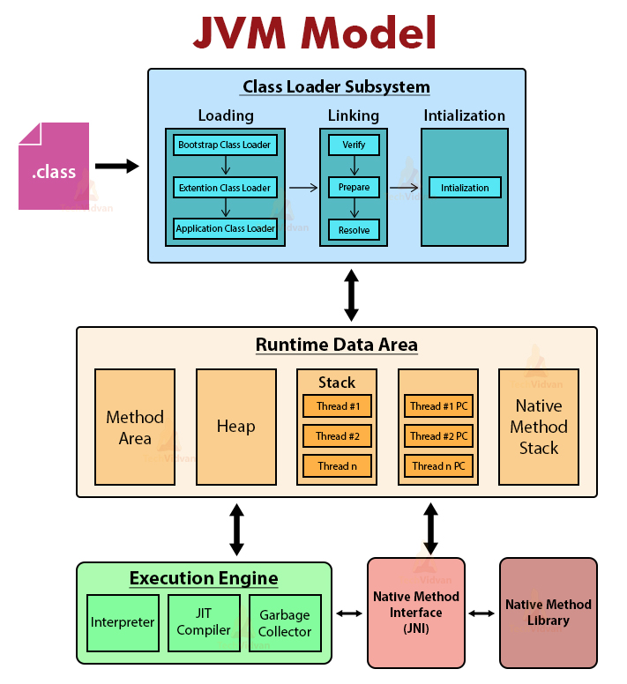
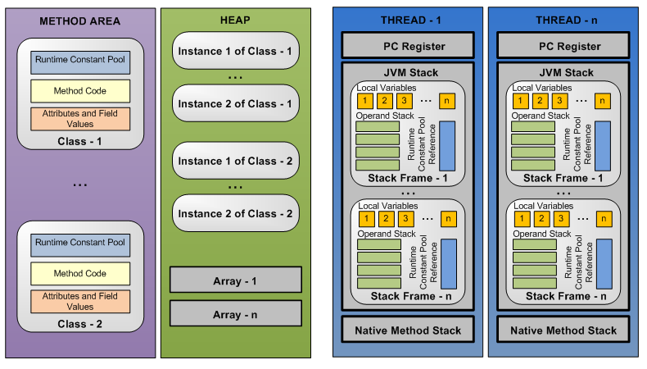

Slide 14
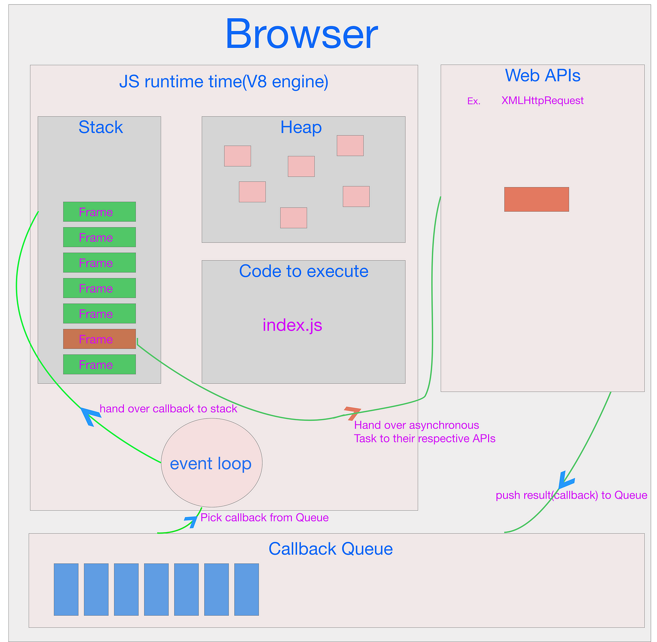
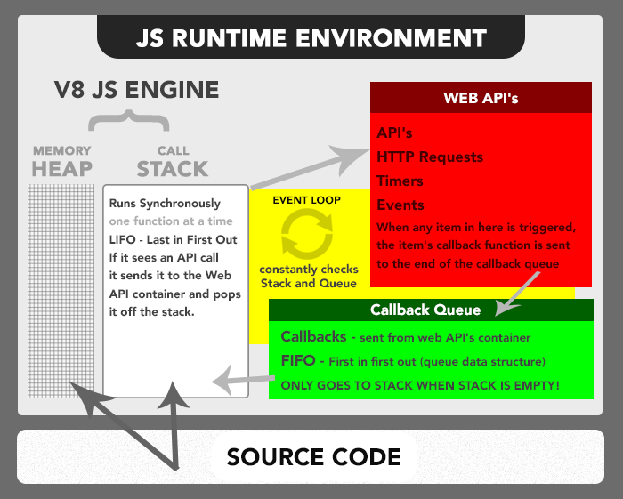

Slide 15

what should we remember at this level?
There are two parts whose efficiency of use depends on the efficiency of our program: Stack & Heap.

Slide 16

Wait, wait, Wait !
Does this imply that it is up to us to manage the allocation and release of memory?

Slide 17

No, but rather help the memory manager to do its job well!

Slide 18
How ?
It is necessary at the beginning to understand how memory is managed: Manual, Automatic Reference Counting or a Garbage Collector.
Next, identify the limitations of each mechanism.
Make a checklist.
Write code that takes these limitations into account.

Slide 19
memory management mechanisms
Allocation and Release of memory

Slide 20
Available Mechanisms
Manual: C, C++
Manual retain-release (MRR): Objective-C
Automatic Reference Counting (ARC): Objective-C, Swift
Garbage Collection (fully automatic management): Java, JavaScript
Ownership: Rust

Slide 21
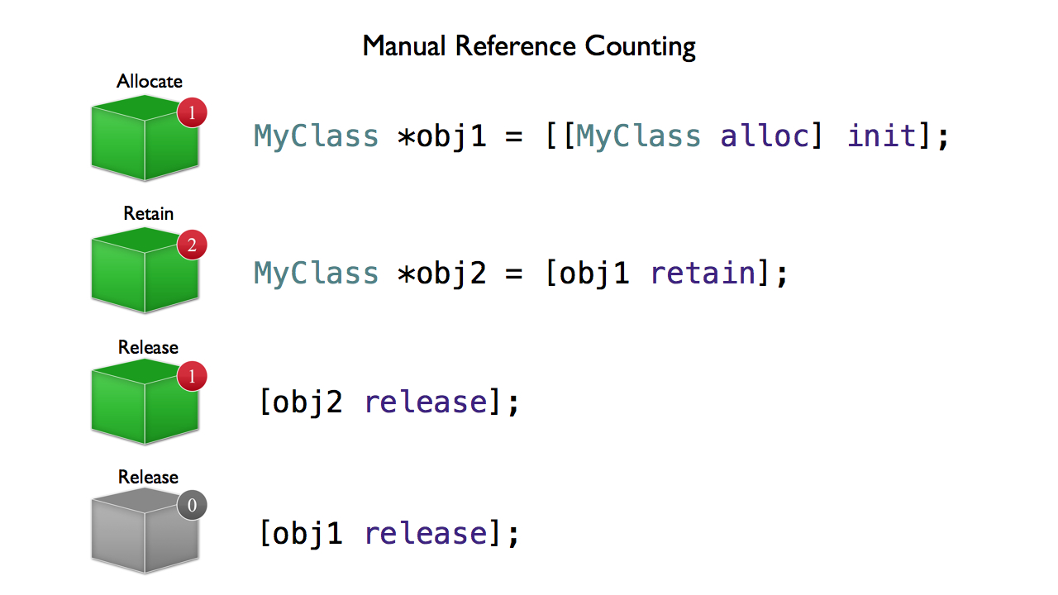
Manual Retain Release (MRR)
C

Slide 22
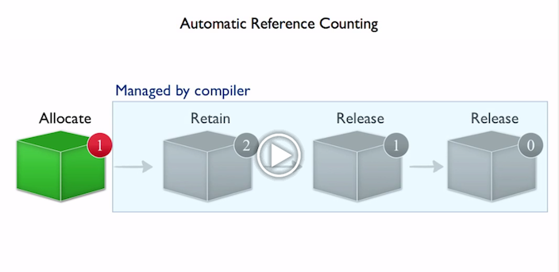
AutomaTIc Reference Counting (ARC)
C

Slide 23
What’s a Garbage Collector?
Automatic garbage collection is the process of looking at heap memory, identifying which objects are in use and which are not, and deleting the unused objects.
An in use object, or a referenced object, means that some part of our program still maintains a pointer to that object.
An unused object, or unreferenced object, is no longer referenced by any part of our program. So the memory used by an unreferenced object can be reclaimed.
In a programming language like C, allocating and deallocating memory is a manual process. In Java, process of deallocating memory is handled automatically by the garbage collector.

Slide 24
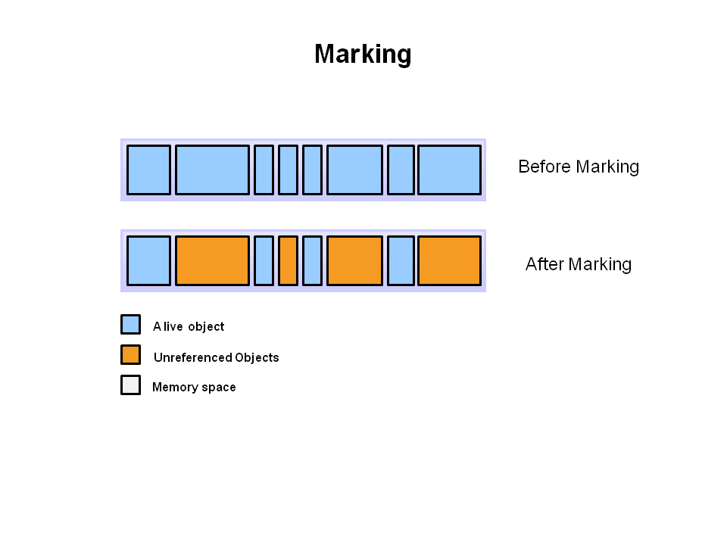
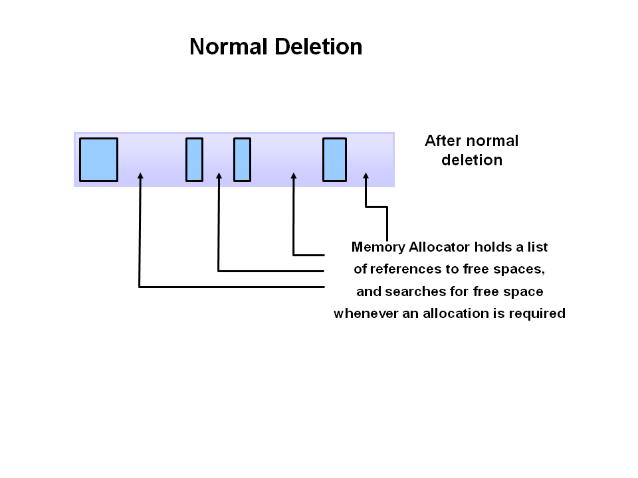
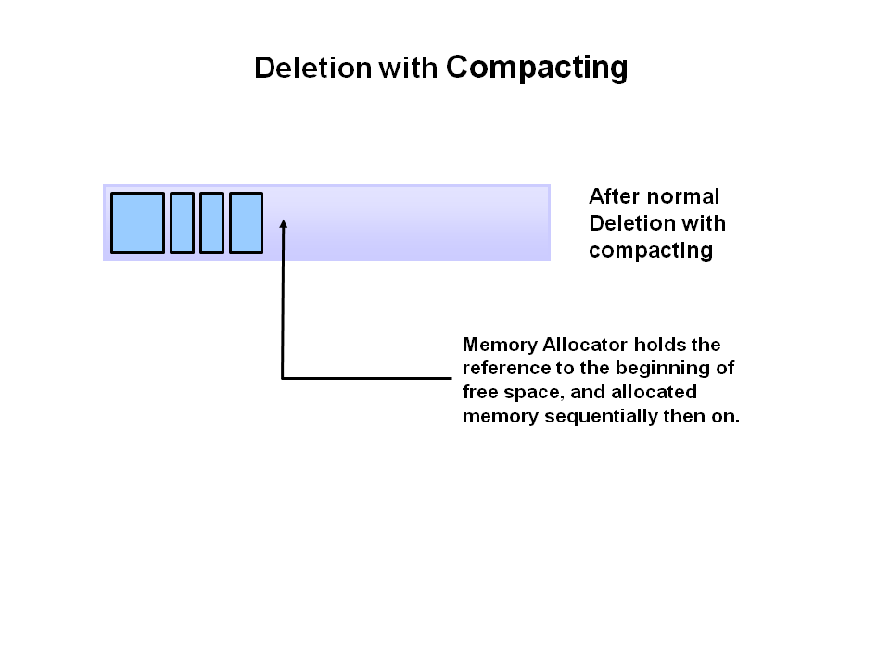
GC: basic process
C
To further improve performance, in addition to deleting unreferenced objects, GC can also compacts the remaining referenced objects. By moving referenced object together, this makes new memory allocation much easier and faster.
The first step in the process is called marking. This is where the garbage collector identifies which pieces of memory are in use and which are not.
Normal deletion removes unreferenced objects leaving referenced objects and pointers to free space.

Slide 25
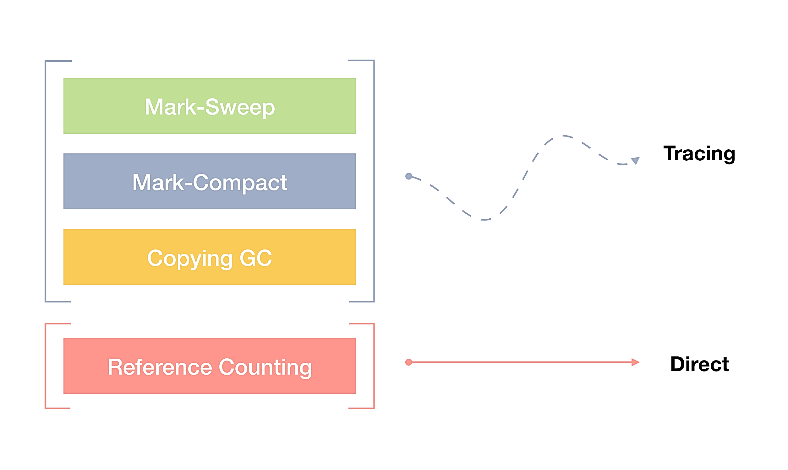
GC Algorithms
C

Slide 26


Mark-Sweep Garbage Collection
A Mark-and-Sweep garbage collector has two phases:
Mark: starting from roots, mark all reachable objects by using a depth-first-search pointer traversal
Sweep: scan the heap from the beginning to the end and reclaim the unmarked objects (and unmark the marked objects).

Slide 27

Mark-Compact Garbage Collection
Mark-Sweep-Compact algorithms solve the shortcomings of Mark and Sweep by moving all marked – and thus alive – objects to the beginning of the memory region.
The downside of this approach is an increased GC pause duration as we need to copy all objects to a new place and to update all references to such objects.
The benefits to Mark and Sweep are also visible – after such a compacting operation new object allocation is again extremely cheap via pointer bumping.
Using such approach the location of the free space is always known and no fragmentation issues are triggered either.

Slide 28
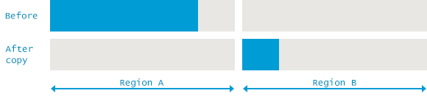
Copying Garbage Collection (Cheney's algorithm)
Memory space is divided in two: From-Space and To-Space.
New arrays are allocated in From-Space.
When From-Space becomes full, program execution stops, and all live data (non-garbage) is copied to To-Space.
From-Space and To-Space are flipped and program execution continues.

Slide 29
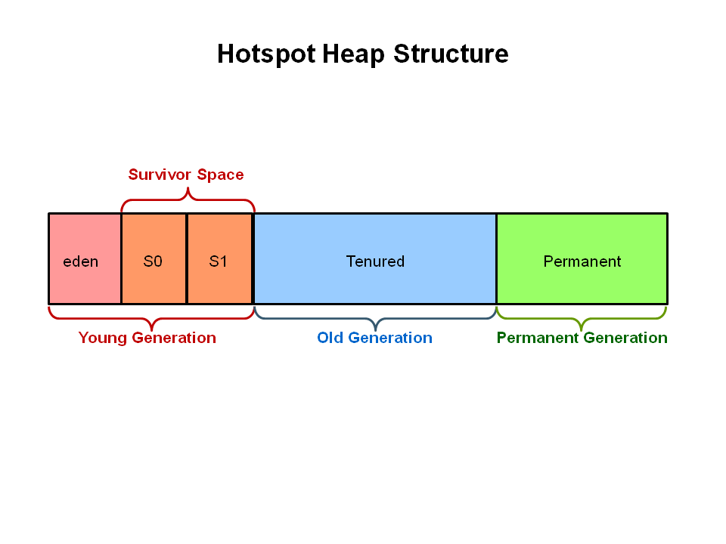
Generational Garbage Collection
As stated earlier, having to mark and compact all the objects in a JVM is inefficient.
As more and more objects are allocated, the list of objects grows and grows leading to longer and longer garbage collection time.
However, empirical analysis of applications has shown that most objects are short lived.
The information learned from the object allocation behavior can be used to enhance the performance of the JVM.
Therefore, the heap is broken up into smaller parts or generations: Young Generation, Old or Tenured Generation, and Permanent Generation

Slide 30
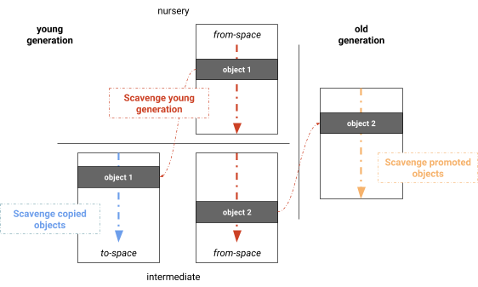
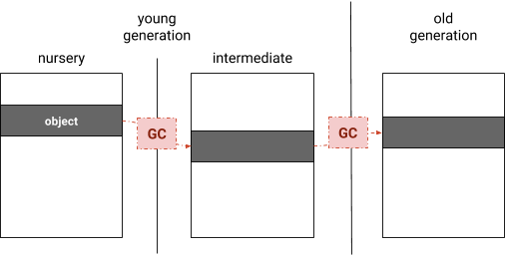
Node.js V8 GC (Orinoco)
Orinoco: young generation garbage collection.
V8 partitions its managed heap into generations where objects are initially allocated in the “nursery” of the young generation.
Upon surviving a garbage collection, objects are copied into the intermediate generation, which is still part of the young generation.
After surviving another garbage collection, these objects are moved into the old generation.

Slide 31
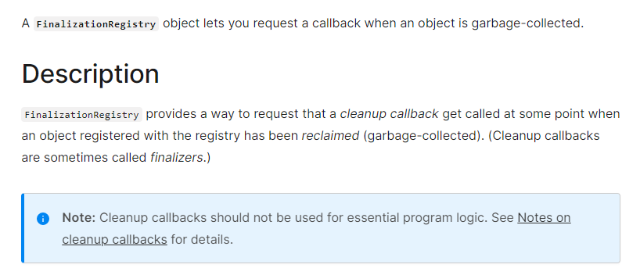
Good to know (FinalizationRegistry)

Slide 32
Java GC algorithms
Concurrent Mark Sweep (CMS) GC
Parallel/Throughput GC
G1 (Garbage-First) GC
Z Garbage Collector (ZGC)

Slide 33

Have you detected a flaw?
C
Let's look !

Slide 34
Memory Violations
When do they occur and how to avoid them?

Slide 35
Types of memory errors
Access errors
Buffer overflow
Buffer over-read
Race condition
Invalid page fault
Uninitialized variables
Null pointer dereference
Dangling and wild pointers
Stack Overflow
Out of Memory (OOM)
Memory leak

Slide 36
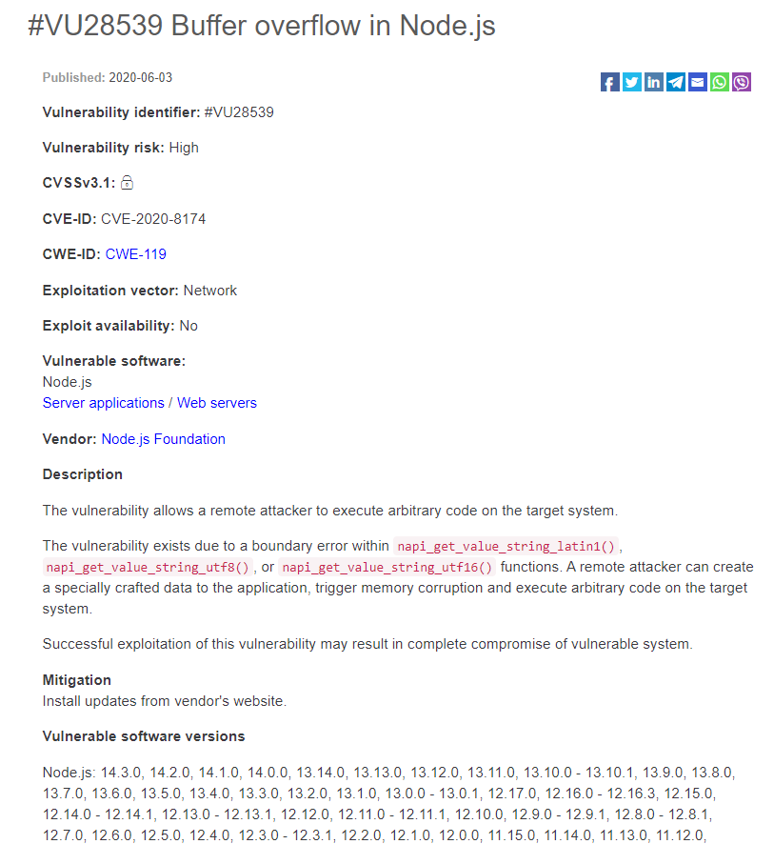
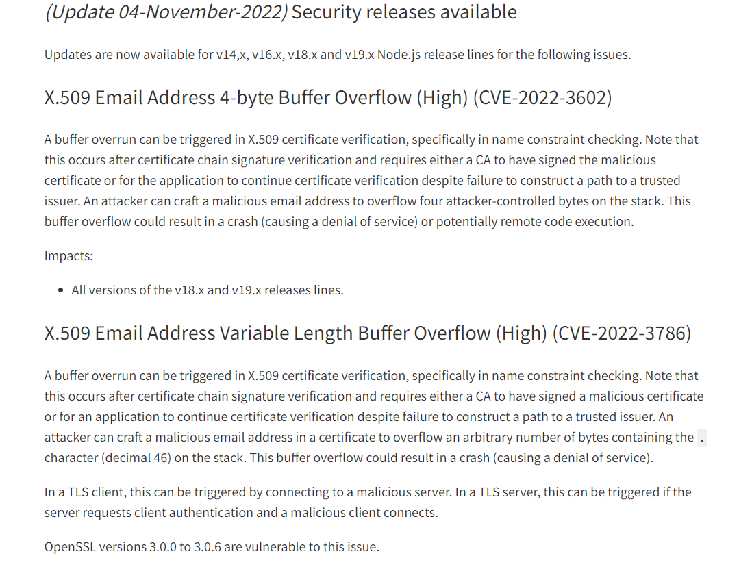
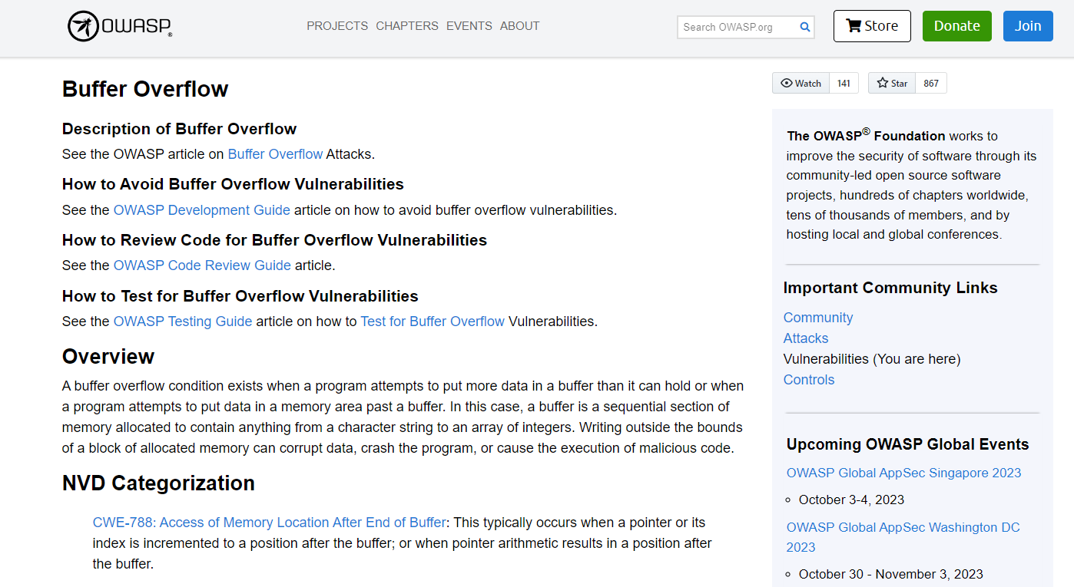

Slide 37
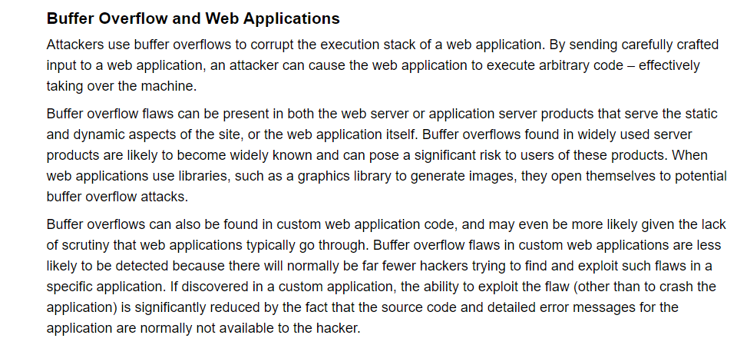
https://owasp.org/www-community/vulnerabilities/Buffer_Overflow

Slide 38
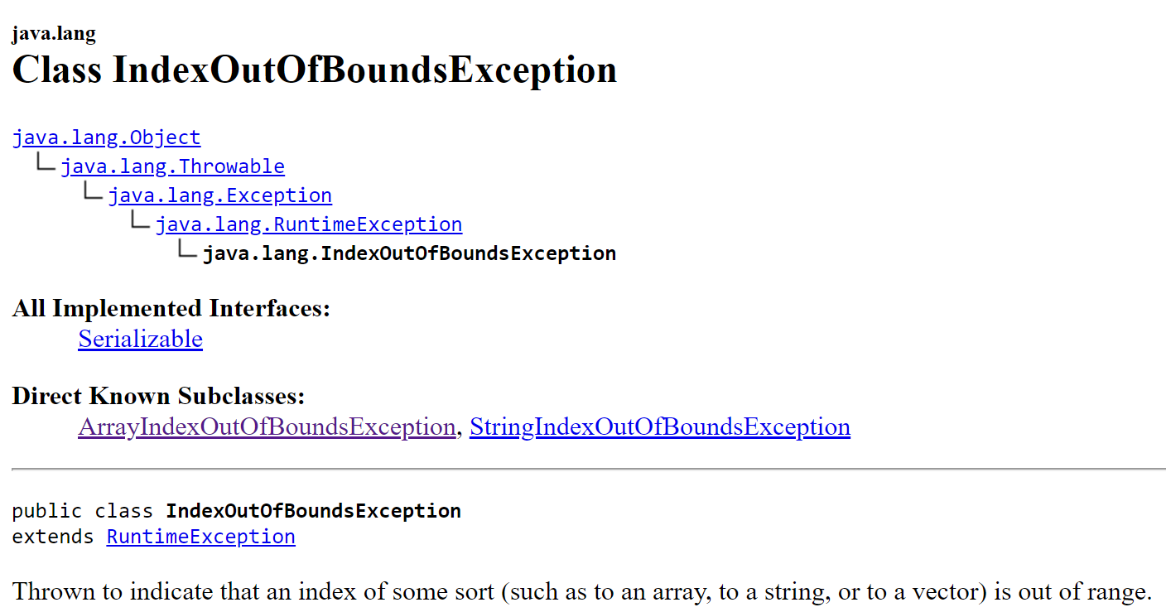
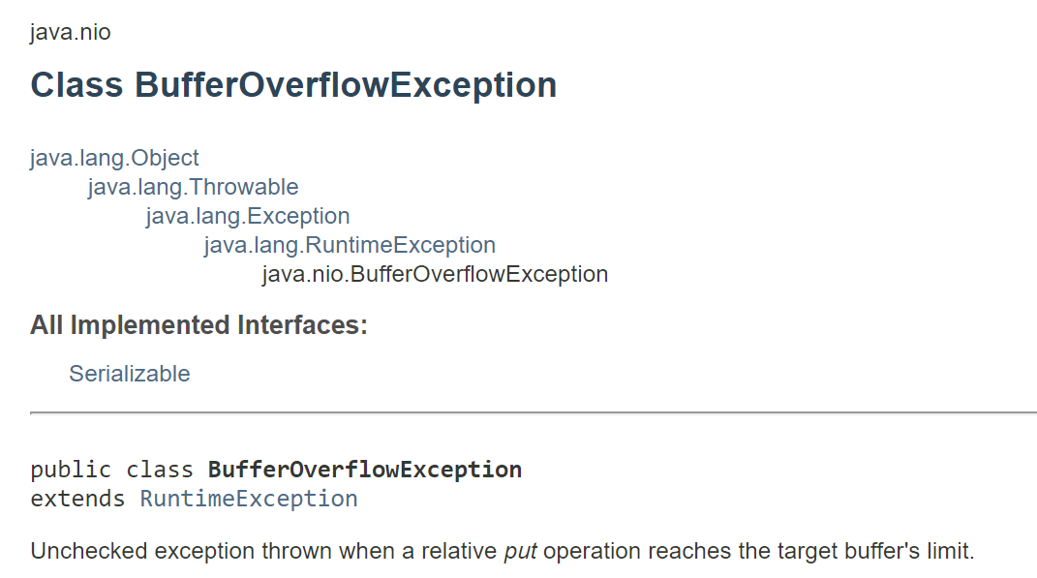
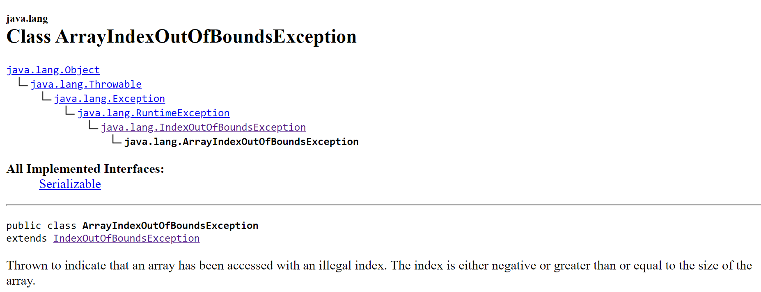

Slide 39
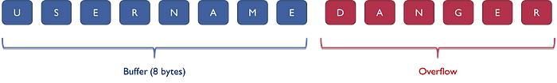
Buffer overflow
Buffer overflow is probably the best known form of software security vulnerability.
A buffer overflow occurs when a program tries to put more data into a buffer than it can hold, or when a program tries to put data into a memory area beyond a buffer.
Buffer overflow vulnerabilities can occur in code that: relies on external data to control its behavior and do not perform bounds checking, and it can easily overwrite the allocated bounds of the buffers they operate upon.
Writing outside the bounds of a block of allocated memory can corrupt data, crash the program, or cause the execution of malicious code.
Buffer is a place to put information temporarily while waiting for something else to process the data or while we’re processing it. For example, when input comes from the keyboard, it is stored in an input buffer until it is read and used by the application.

Slide 40
Buffer overflow
To avoid this type of violation, we need to verify all code that accepts input from users via the HTTP request and ensure it provides appropriate size and type checking on all such inputs.
It’s also recommended to validate that array indices are within the proper bounds before using them as an index to an array.

Slide 41
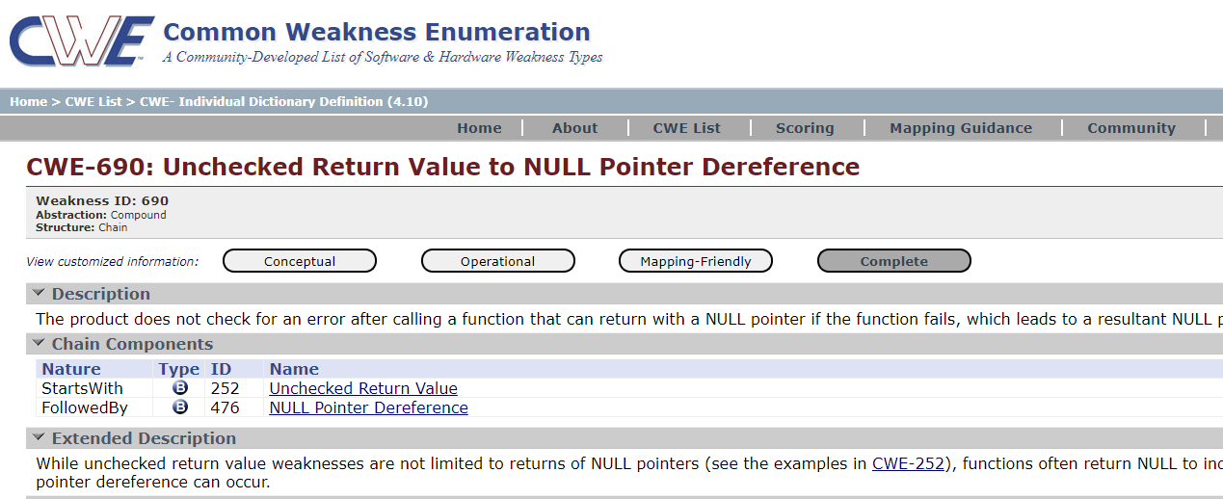
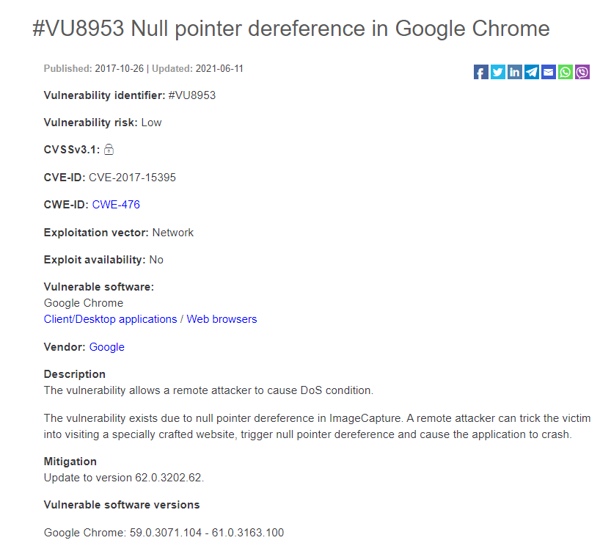
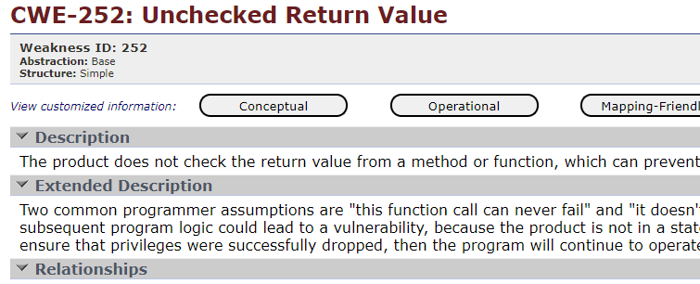
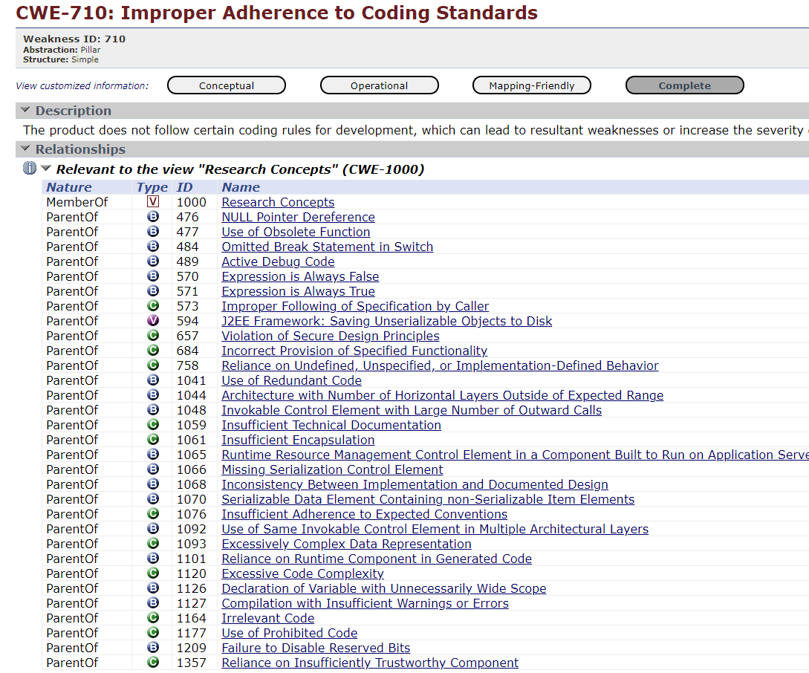
Null Pointer Dereference

Slide 42
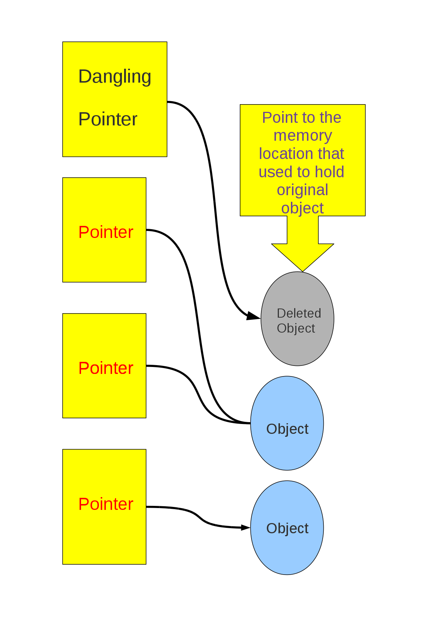
Dangling pointers
The dangling pointer arises when the referencing object is deleted or deallocated and the pointer still pointing to a memory location.
It creates a problem because the pointer is pointing to the memory that is not available.

Slide 43
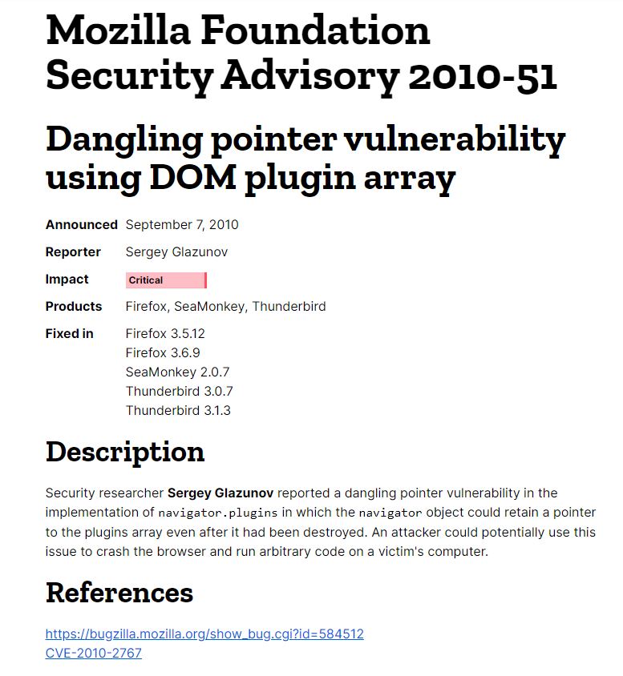
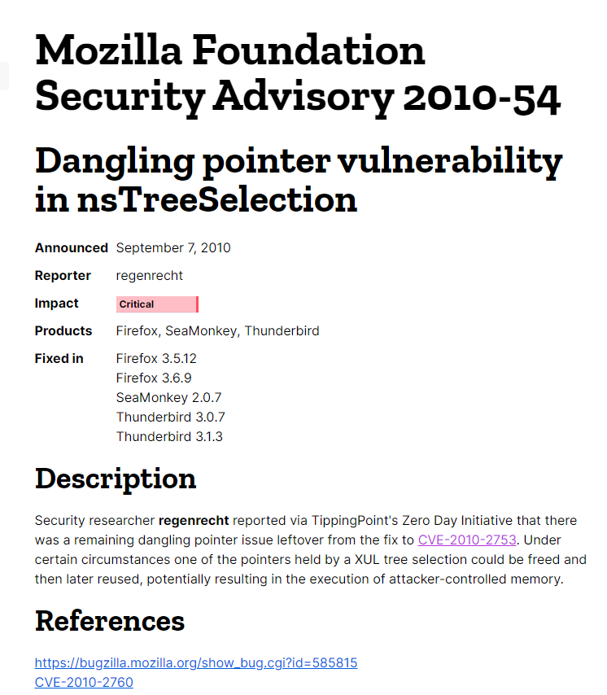

Slide 44
Promise & Dangling Pointers
If something is still holding a reference to the Promise resolve, the effect and everything in its lexical scope will stay alive even after the component has unmounted.
const MyComponent = () => { const [status, setStatus] = useState(''); useEffect(async () => { await asyncOperation(); if (isMounted()) { setStatus('Great success'); } }, []); return <div>{status}</div>; }
const [isVisible, setIsVisible, ] = useState(true); useEffect(() => { let cancel = false; someAsyncFunction().then(() => { if (cancel) return; setIsVisible(false); }); return () => { cancel = true; }; }, []);
isMounted is an Antipattern – React Blog (reactjs.org)

Slide 45
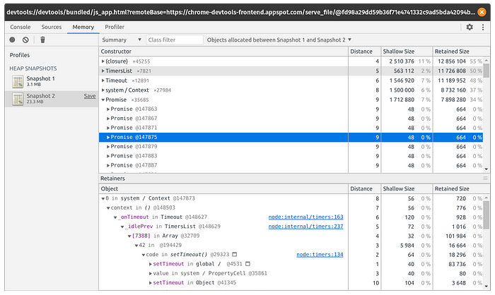
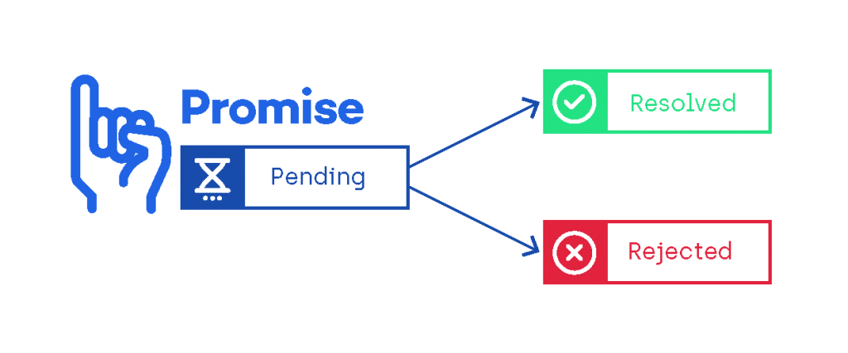
Dangling / Floating Promises
Promises get stored in memory and they do not clear until they are either handled or rejected !
The program stopped, but the promises that never got resolved stayed in memory.

Slide 46
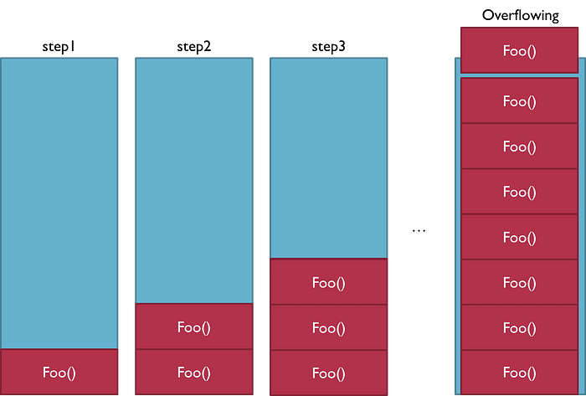
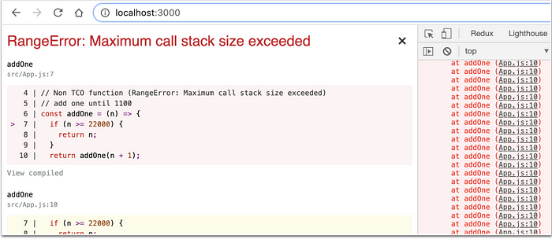
Stack Overflow
C

Slide 47
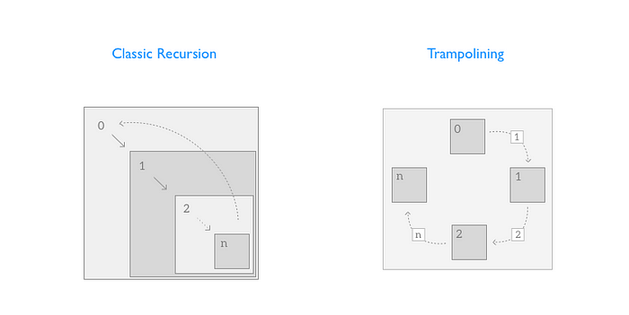
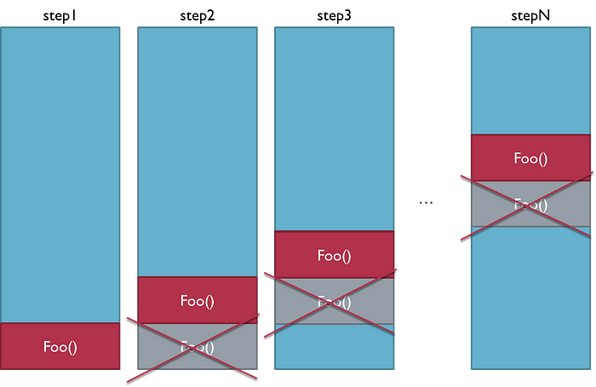
Stack Overflow: Tail Call Optimization & Trampoline
https://en.wikipedia.org/wiki/Trampoline_(computing)

Slide 48
Java & Javascript Trampoline
awt-react-extras Module: TailCallExecutor (world.socgen)
Trampoline | Java Design Patterns (java-design-patterns.com)

Slide 49
Out of Memory (OOM)
This error occurs when there is insufficient space to allocate an object in the Heap, and the Heap cannot be expanded further. In this situation, the GC can’t help!
OOM error usually means that the program is doing something wrong, such as the following:
- holding onto objects too long
- trying to process too much data at a time
- having many global variables (a problem in function and variables scoop)
For example, in JavaScript, the references that are directly pointed to the root (global or window) are always active (used), and the GC cannot clear them!

Slide 50
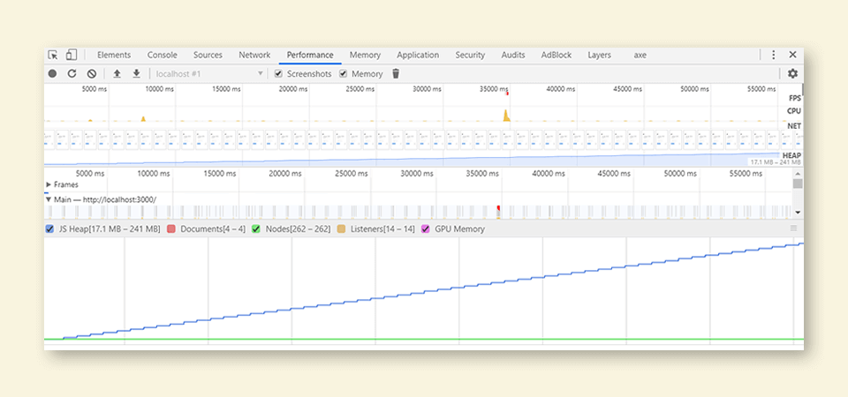
OOM
C

Slide 51
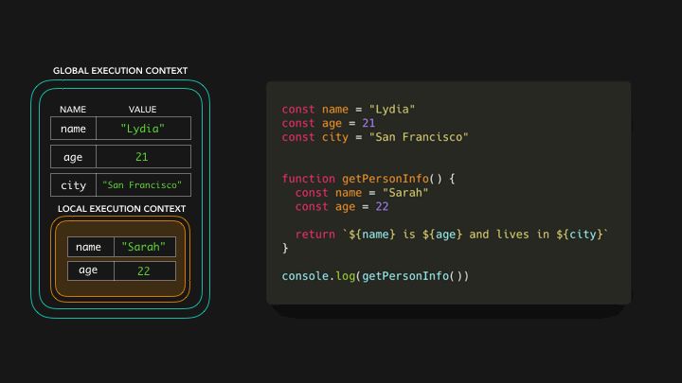
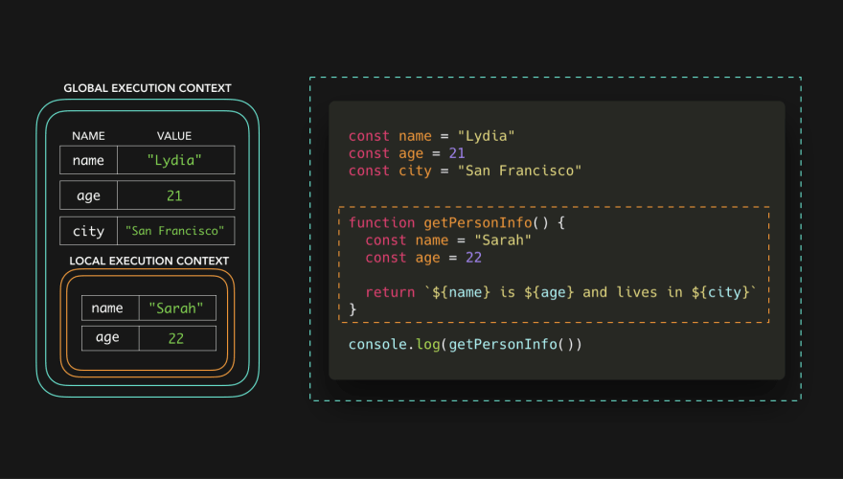
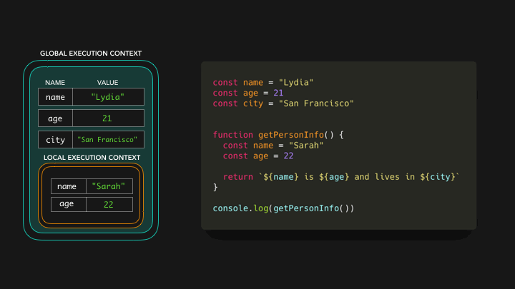
Javascript Scope

Slide 52
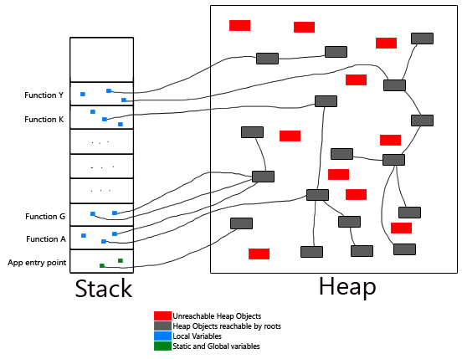
Undeclared or accidental global variables
When a undeclared variable is referenced, javascript creates a new variable in the global object.
Since the scope of the global variables never end, they remain in memory throughout the execution of the page even if they are not needed.
The more the global variables, the more the memory leakage.

Slide 53
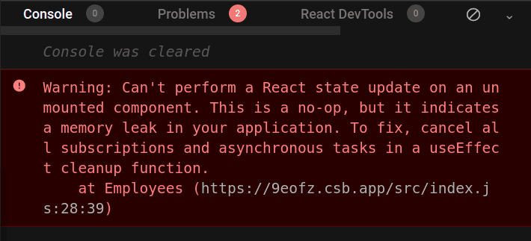
Memory leak: Forgotten timers (setTimeout and setInterval)
const MonComposant = () => { const [ count, setCount, ] = useState(0); useEffect(() => { const timer = setTimeout(() => { setCount('Timeout called!'); }, 1000); return () => clearTimeout(timer); }, []); return ( <span> Current Count: {count} </span> ); }; export default MonComposant;
const MonComposant = () => { const [ countInterval, setCountInterval, ] = useState(0); useEffect(() => { const interval = setInterval(() => { setCountInterval(countInterval + 1); }, 1000); return () => clearInterval(interval); }, []); return ( <span> Current Count: {countInterval} </span> ); }; export default MonComposant;

Slide 54
Memory leak: Out of DOM reference (Event listeners)
const hugeString = new Array(100000).join('x'); document.addEventListener('keyup', function() { // anonymous inline function - can't remove it doSomething(hugeString); // hugeString is now forever kept in the callback's scope });
function listener() { doSomething(hugeString); } document.addEventListener('keyup', listener); // named function can be referenced here... document.removeEventListener('keyup', listener); // ...and here
document.addEventListener('keyup', function listener() { doSomething(hugeString); }, {once: true}); // listener will be removed after running once

Slide 55
Memory leak: Out of DOM reference (Event listeners)
class MyComponent extends React.Component { constructor(){ super(props) this.handleClick = this.handleClick.bind(this) } handleClick = () => { //do something when we clicked } componentDidMount() { document.addEventListener("mousedown", this.handleClick); } componentWillUnMount() { document.removeEventListener("mousedown", this.handleClick); } render() { renturn ... } } export default MyComponent
import React, { useEffect, } from 'react'; const MonComposant = () => { const handleKeyDown = (event) => { console.log('A key was pressed', event.keyCode); }; useEffect(() => { window.addEventListener('keydown', handleKeyDown); // cleanup listener return () => { window.removeEventListener('keydown', handleKeyDown); }; }, []); return ( <span> Hello ! </span> ); }; export default MonComposant;
https://github.com/facebook/react/issues/12947

Slide 56
Multithreading and Race condition
In a race condition, shared memory can be corrupted by threads.
Various mechanisms such as locks (synchronized) and semaphore may be used to control access to the shared memory.
Java offers several data structures allowing concurrent access: DelayQueue, BlockingQueue, ConcurrentMap, ConcurrentHashMap.
Node.js is single threaded. However we can do parallelism using worker threads.

Slide 57
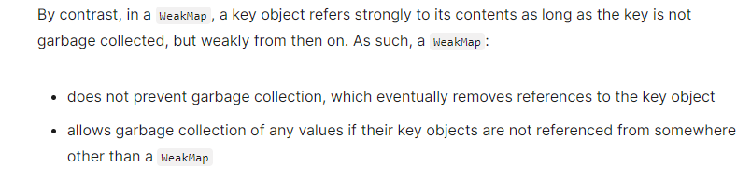
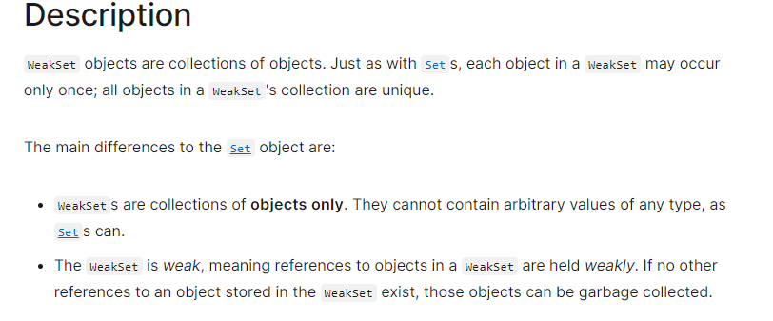
Good to know: WeakMap and WeakSet
https://blog.carbonteq.com/javascript-garbage-collection/

Slide 58
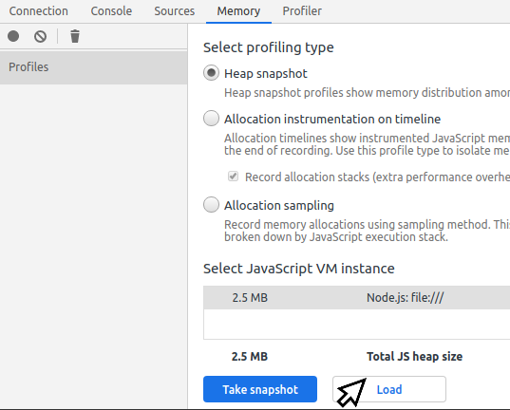
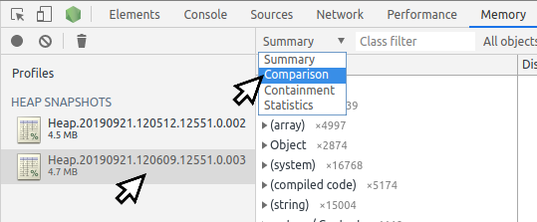
Tips: Node.js memory analysis
Create DUMP / Snapshot
Upload to Chrome Memory Tab
https://nodejs.org/en/docs/guides/diagnostics/memory/

Slide 59
conclusion
let's summarize!

Slide 60
Conclusion
Automatically managing memory is important but not sufficient.
Some memory issues can occur even in a run-time with a GC.
Buffer overflow, Buffer over-read, Null dereference, dangling and wild pointers, Stack Overflow, and out of memory (OOM) are exceptions for all programming languages.
They are more related to an “unsafe” coding defect than an internal problem in the programming language or the runtime.
The most important piece of advice is to take a defensive approach in writing code.
A program should be able to run properly even through unforeseen processes or when unexpected entries.

Slide 61


Slide 62


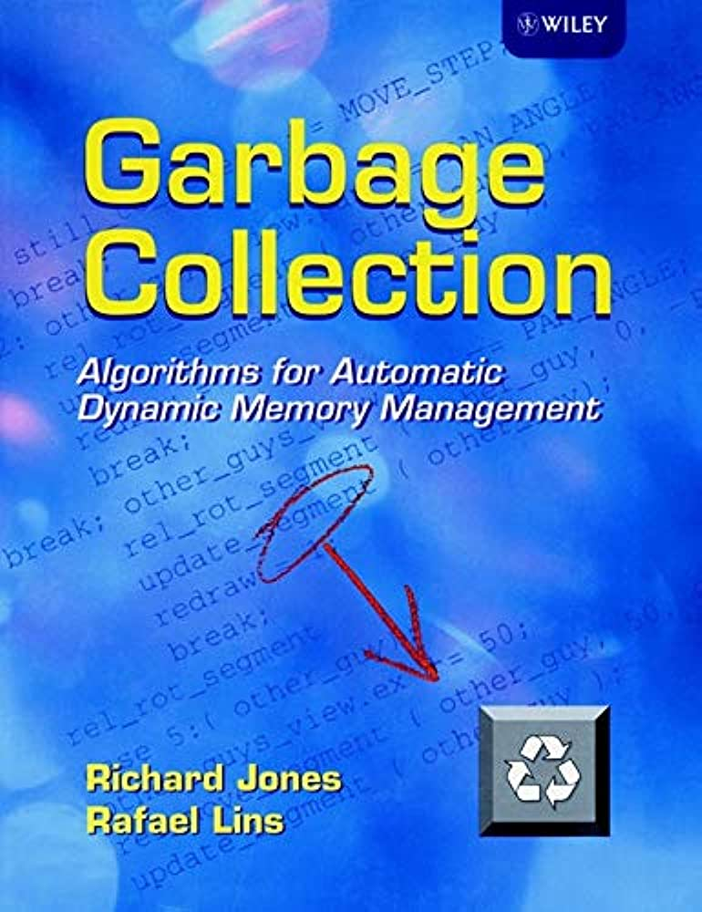
Books
C

Slide 63

Thank you !
C
Ressources

Slide 64

Open Philosophical Question
C
Are you satisfied with the current status of programming languages?

